Slide 1
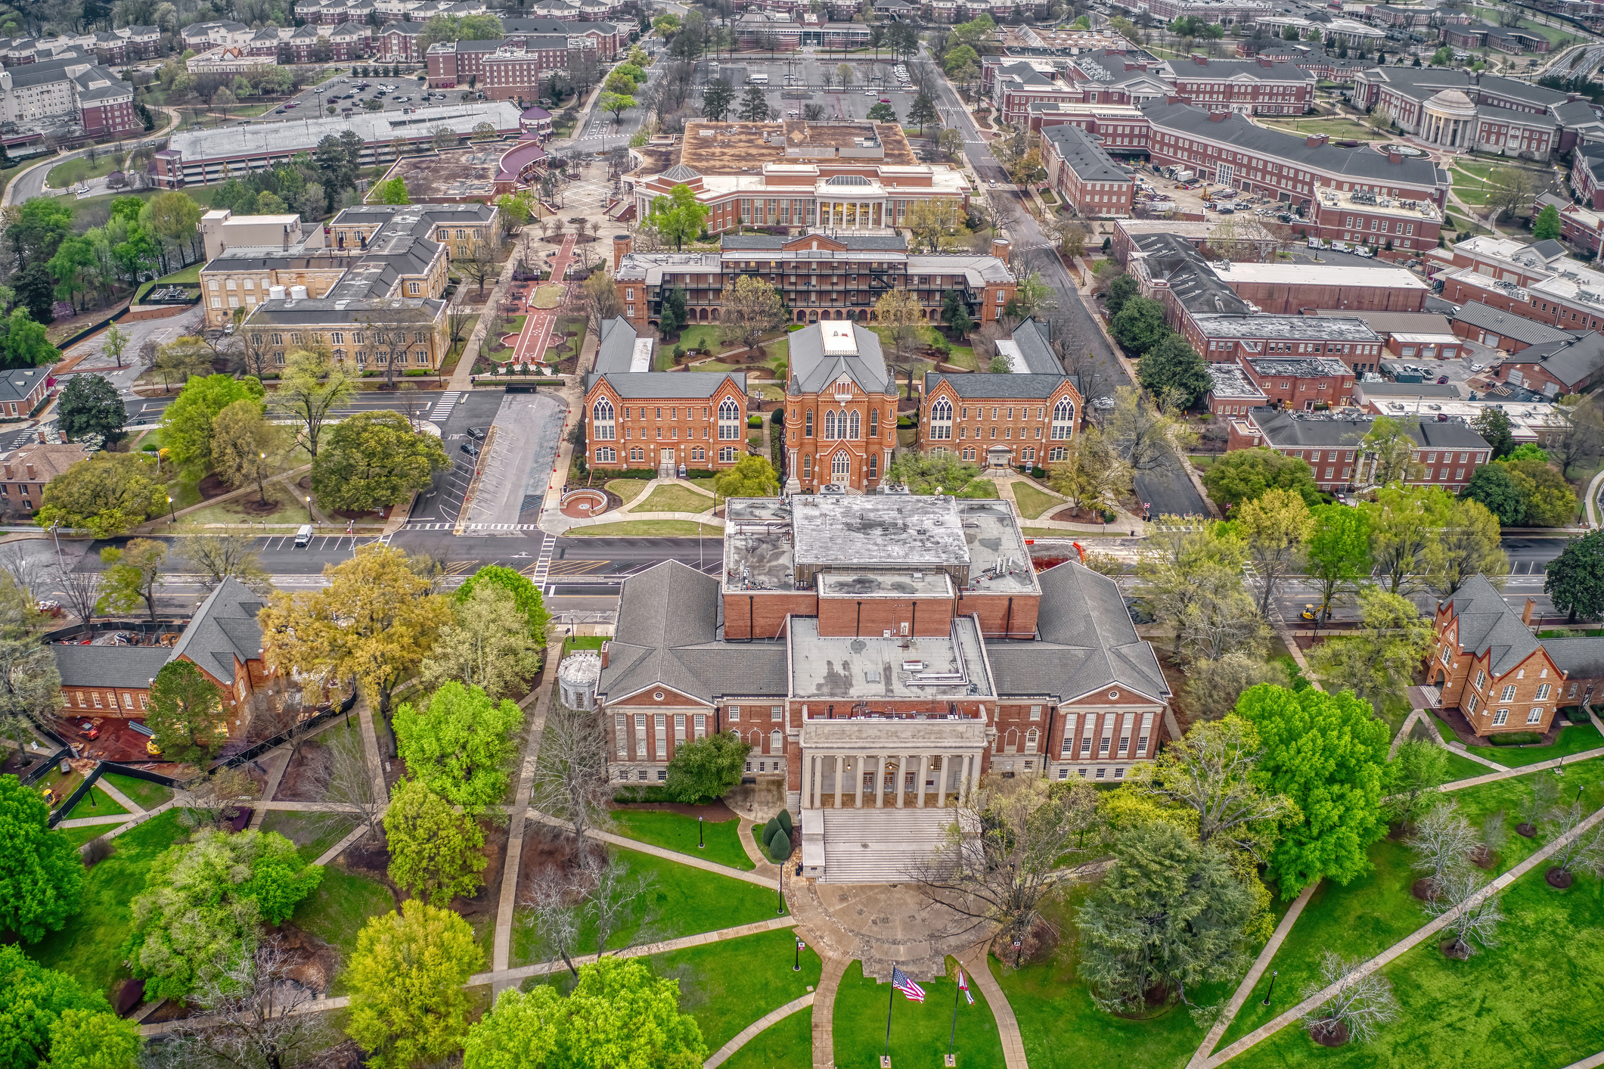

CONTENT CONFERENCE SERIES
Large Headline Treatment Shown Here for Placement
PRESENTED BY FIRSTNAME LASTNAME

Slide 2
Headline Treatment Shown Here for Placement
Nequatus, natatiis aut ducienis ant aribus et lam invenimusda vid magnimin cum quia net evenimus nonem ipsapel lorehentia niendenit maxim vollessimin rempora doluptur, consequatis quod ut licid molupta demquia sitibusam quam haribusam aliquas dolectat. Obitia doluptas quia perore lamusaepe nonse sum ullia doloratur, sequia erum esto maio el id maximus tibus.
2

Slide 3



Divider Headline Treatment Shown Here for Placement
3

Slide 4

Divider Headline Treatment Shown Here for Placement
4

